Slide 1
Preparing Your Soil & Deer Resistant Perennials
Becky Pulver – 801-564-0699
pulver2004@msn.com

Slide 2
Resources
Perennial Favorites – perrenialfavoites.com
Proven Winners - provenwinners.com
J & J’s Garden Center – jjgardencenter.com
https://extension.usu.edu/yardandgarden/

Slide 3
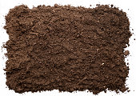
Components of a healthy soil
Native garden soil – Garden soil or top soil. I’m not a fan of soilless garden mixtures. Native garden soil as long as it doesn’t have disease in it, is, I feel, very important to your garden.
Compost or Organic Matter - High in Nitrogen and other minerals. Aids in drainage.
Peat Moss – Helps with moisture and nutrient retention. It releases moisture to the plants as needed.
Vermiculite – Acts like a sponge and holds onto moisture and nutrients.
Perlite – Acts as an aerator and allows excess water to be released.

Slide 4
Deer Resistant Perennials and shrubs
Yarrow Monkshood (P) Bugbane Hyssop
Ladys Mantle Alyssum Anemone Columbine
Wormwort Blue Star Summer Forget Me Not Goatsbeard
Butterfly Weed Aster Astilbe Basket of Gold
False Ingigo Bergenia Calamint (Catmint) Lily of the Valley
Coreopsis Ice Plant Larkspur Bleeding Heart
Fox Glove Cone Flower Spurge Fern
Blanket Flower Cranes Flower Babys Breath Lanten Rose
Iris Lamium Red Hot Poker Lavendar
Shasta Daisy Flax Bee Balm Peony
Poppy Penstemon Russian Sage Jacobs Ladder
Salvia Hens and Chicks Lambs Ear Speedwell

Slide 5
Deer Resistant Perennials and shrubs cont.
Common Boxwood Japanese Pieris Mountain Laurel Eastern Red Cedar
Chinese Juniper Ink Berry Juniper Arrowwood Viburnum
Blue Beard Butterfly Bush Roses Bayberry
There is not a plant or shrub that is totally resistant to deer. If they are hungry, they will
eat anything. These plants and shrubs will just be a little less appetizing to them.

Slide 6
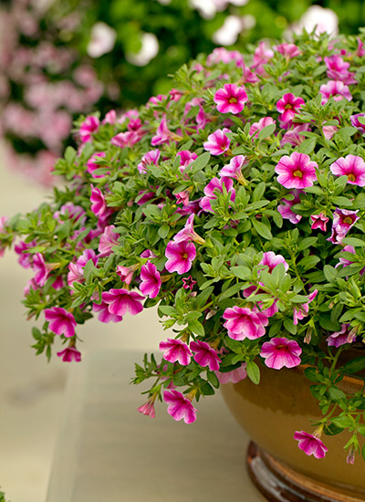
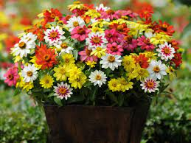
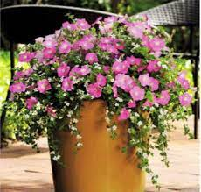
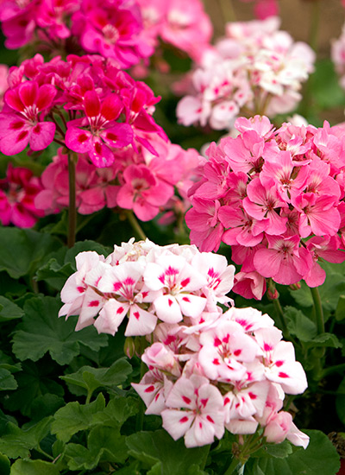
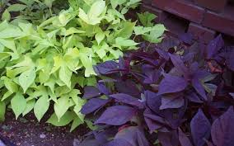
Top Plants For Sun Plantings
Petunias
Bacopa
Geraniums
Ivy type
Calabrachoa
Zinnia
Sweet Potato
Vine

Slide 7
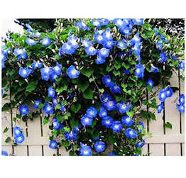
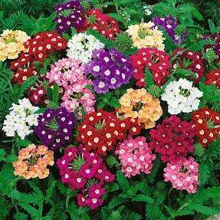
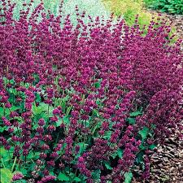
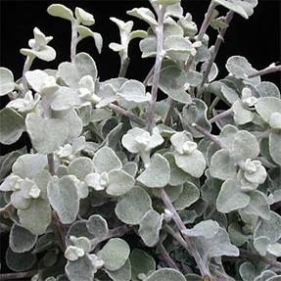
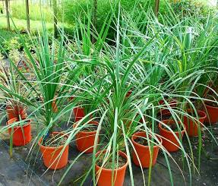
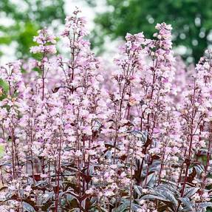
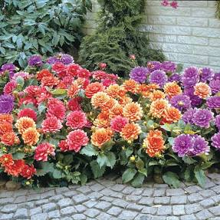
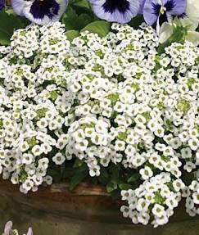
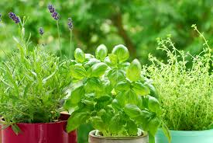
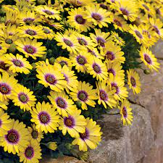
Verbena
Superbena
Lobelia
Salvia, different
varieties/colors
Licorice
plant
Grasses
Spikes
Penstemone
Dahlia
Sweet Alyssum
Herbs
Daisy

Slide 8
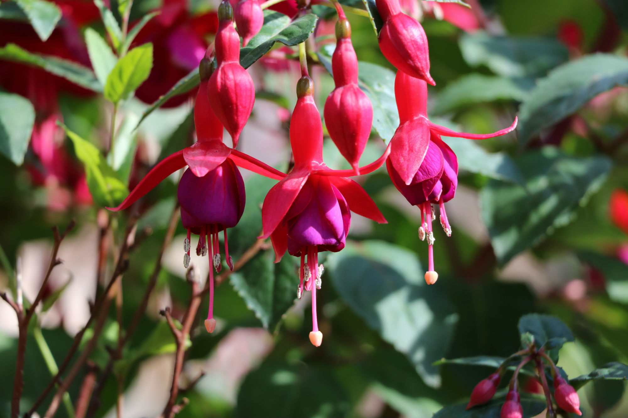
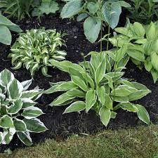
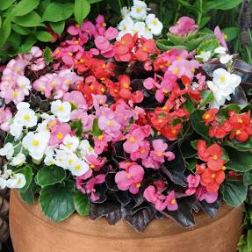
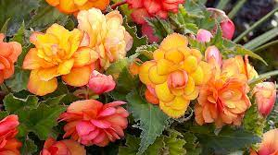
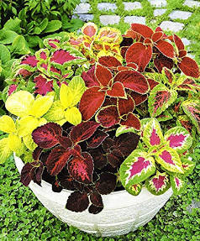
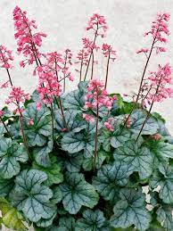
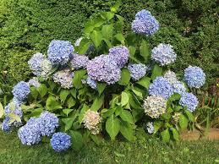
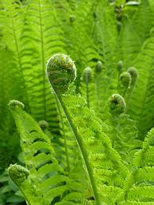
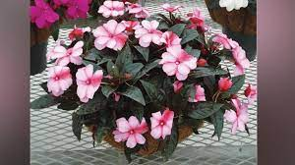
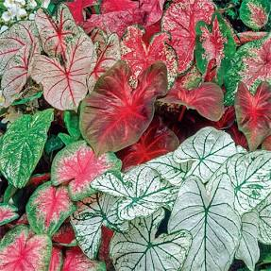
Top Shade Plants For Pots
Fucia
Hosta
Seed Begonia
Tuberous Begonia
Hosta
Heuchera
Hydrangea
Fern
Impatiens
Caladium

Slide 9
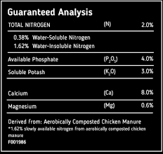
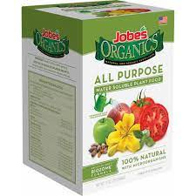
Fertilizer
Nitrogen – Green and growth. Most highly
used up.
Phosphorus - Aids in nutrient transfer.
Rooting and blooming.
Pot Ash or Potassium - Strengthens plants
Helps them with disease,
Drought tolerance. Roots
and stems.

Slide 10
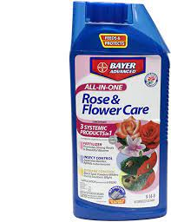
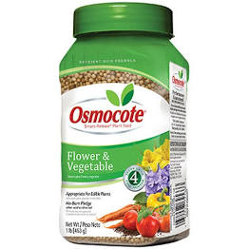
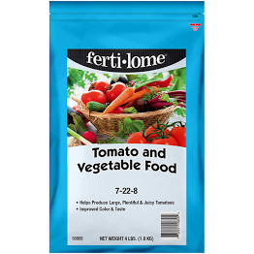
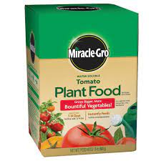
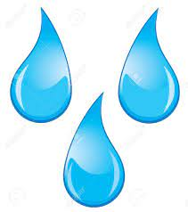
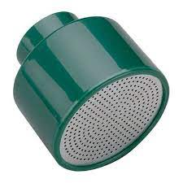
Potted Plants MUSTS!!! *There are other brands that carry the same as these items. Just compare the ingredients and guaranteed analysis
Systemic pest
control
Slow release
3 mo. food
Blooning and
fruiting
Water soluable
Water
Gentle Shower
Or drip.
These are required for a healthy potted plant. Depending on the size and type of pot, you will need to water
And feed more then those plants in the ground.

